Slide 1
OCCULTATION OF REGULUS BY ASTEROID DAGMAR FROM SAUDI ARABIA
PAUL D. MALEY
NASA JOHNSON SPACE CENTER ASTRONOMICAL SOCIETY & IOTA
HOUSTON, TEXAS

Slide 2
INTERNATIONAL ASTEROID OCC SUCCESSES
Georgetown, Guyana -Dec. 11, 1979 Metis occultation (1st photo taken)
Barquisimeto, Venezuela -Oct.2001 Titania
Clinton BC, Canada -Oct. 2004 Flora
Pense, Saskatchewan, Canada -Aug. 2005 Julia
Varadaro, Cuba -Mar. 2008 Germania
Bruderheim, Alberta, Canada -Aug. 2008 Ate
Shaqlawa, Iraq -Apr 2011 Peraga
Nikoi Island, Sumatra, Indonesia -Mar. 2013 Daphne
Cullinan, S. Africa -Jul 2014 Patientia
Thuwal, Saudi Arabia -May 2015 Dagmar
Damdama Lake, India -Oct 2015 Dione

Slide 3
INTERNATIONAL ASTEROID OCC FAILURES
Japan
Abkhazia
Panama
Brazil
Taiwan
Australia
Lord Howe Island, Australia
Mexico
France
Tanzania
Abu Dhabi
Dubai
Greece
Macedonia
Turkey
Bosnia-Hercegovina… and others I have chosen to forget

Slide 4
Qalb al-Asad = paw of the Lion

Slide 5
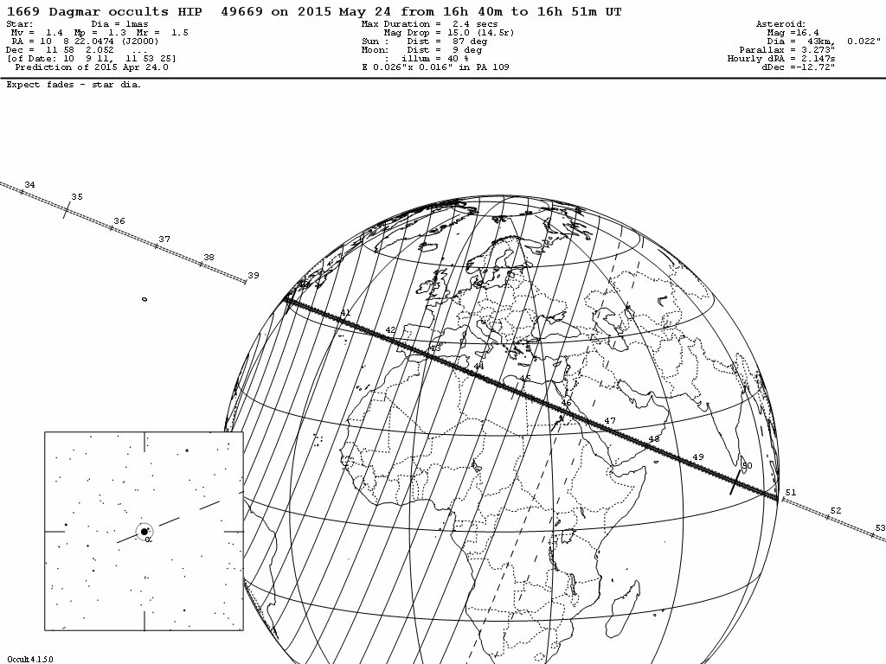

Slide 7
THE PREDICTED PATH

Slide 8
THE DAY OF OUR ARRIVAL

Slide 9
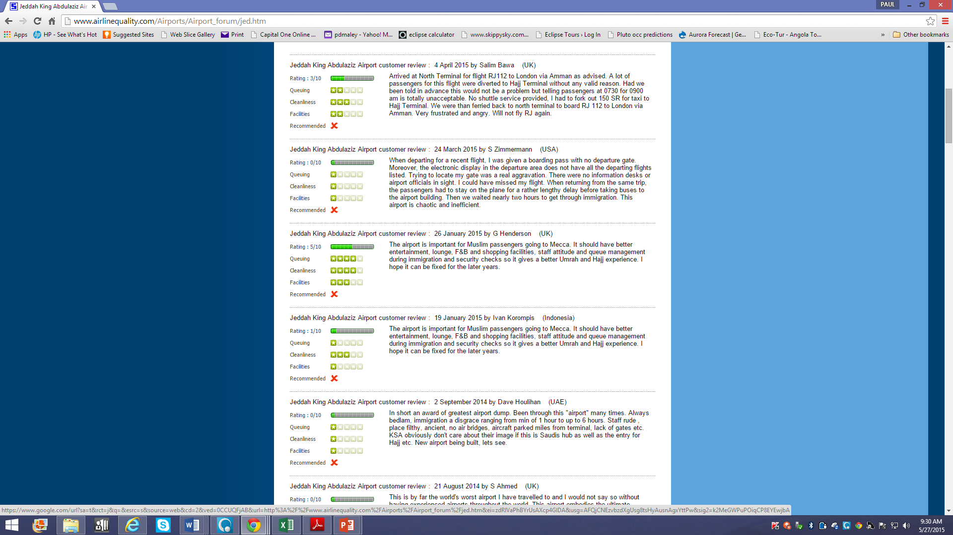

Slide 11
LOCAL PUBLICITY

Slide 40
THUWAL, SAUDI ARABIA

Slide 41
ASSIGNMENTS WERE ABITRARILY MADE

Slide 43
Assuming I was the only one there

Slide 44
Plot with definite “misses”

Slide 45
A unplanned observation assuming observation is south of center

Slide 46
Assuming observation was north of center

Slide 47
New OBSERVATION(2) + Sumatra ADDED AFTER THE EVENT GIVES FINAL SOLUTION

Slide 48
An accidental use of a 35mm DSLR with video

Slide 49
THE END

